Slide 1
ASP.NET Core Introduction
Notes:
So what is .NET?

Slide 2
Benefits

Slide 3
ASP.NET Core Benefits
Multiplatform
Real open-source
Performance
Languages - C#, F#...
New configuration system
Easy to use with Docker

Slide 4
ASP.NET Core Benefits (cont.)
Side by side execution
Joined MVC and Web API
Excellent for REST APIs
Plays great with modern web tools
Blazor - full-stack C#
Part of the .NET future

Slide 5
Basics

Slide 6
Project files
.csproj SDK project file type
Lot simpler than in .NET Framework
Configure project properties and dependencies

Slide 7
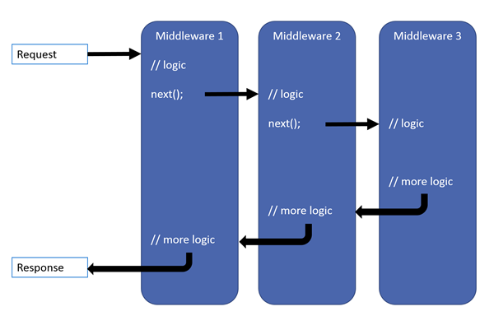
Middleware pipeline
Notes:
Image taken from the blog post by Thomas Levesque: https://thomaslevesque.com/2018/03/27/understanding-the-asp-net-core-middleware-pipeline/

Slide 8
Request Pipeline
Https Redirection
Static Files
Authorization
MVC Handler
App Code
Routing
CORS
Authentication
Endpoint

Slide 9
ASP.NET Core Request Processing
MVC Handler
Authorization Filters
Https Redirection
Static Files
Authorization
Routing
CORS
Authentication
Endpoint
Resource Filters
App Code
Model Binding
Action Filters
Controller Action execution
Exception Filters
Result Filters
Result execution

Slide 10
ASP.NET Core Request Processing
MVC Handler
HTTP Request
Https Redirection
Static Files
Authorization
Routing
CORS
Authentication
Endpoint
IIS
.NET
Core
CLR
Kestrel
Main()
Configure()
App Code
HTTP Response

Slide 11
ASP.NET Core Request Processing
HTTP
Request
IIS
.NET
Core
CLR
Kestrel
Main()
Configure()
App Code
Pipeline
HTTP
Response
NGINIX YARP

Slide 12
Dependency Injection
Inversion of Control (IoC) between classes and dependencies
Lifetime - transient, scoped, singleton
Services (dependencies) registered in Startup class

Slide 13
Dependent classes
Class A uses method foo() from Class B
In other words
Class A depends from Class B
Class A
B.foo()
Class B
foo ()

Slide 14
Class lifetime dependency
Class A needs Class B object for proper functioning
so
Class A decides when Class B is instantiated
Class A
var b – new B()
b.foo()
Class B
foo ()
Notes:
Zależność czasu życia klas

Slide 15
Dependency inversion
Class A
IB ib ??
ib.foo()
Separate and invert dependencies
We introduce Interface for separating dependencies:
Loosly coupled
Both Classes depends from Interface, not on each other.
interface IB
foo ()
Class B : IB
foo ()

Slide 16
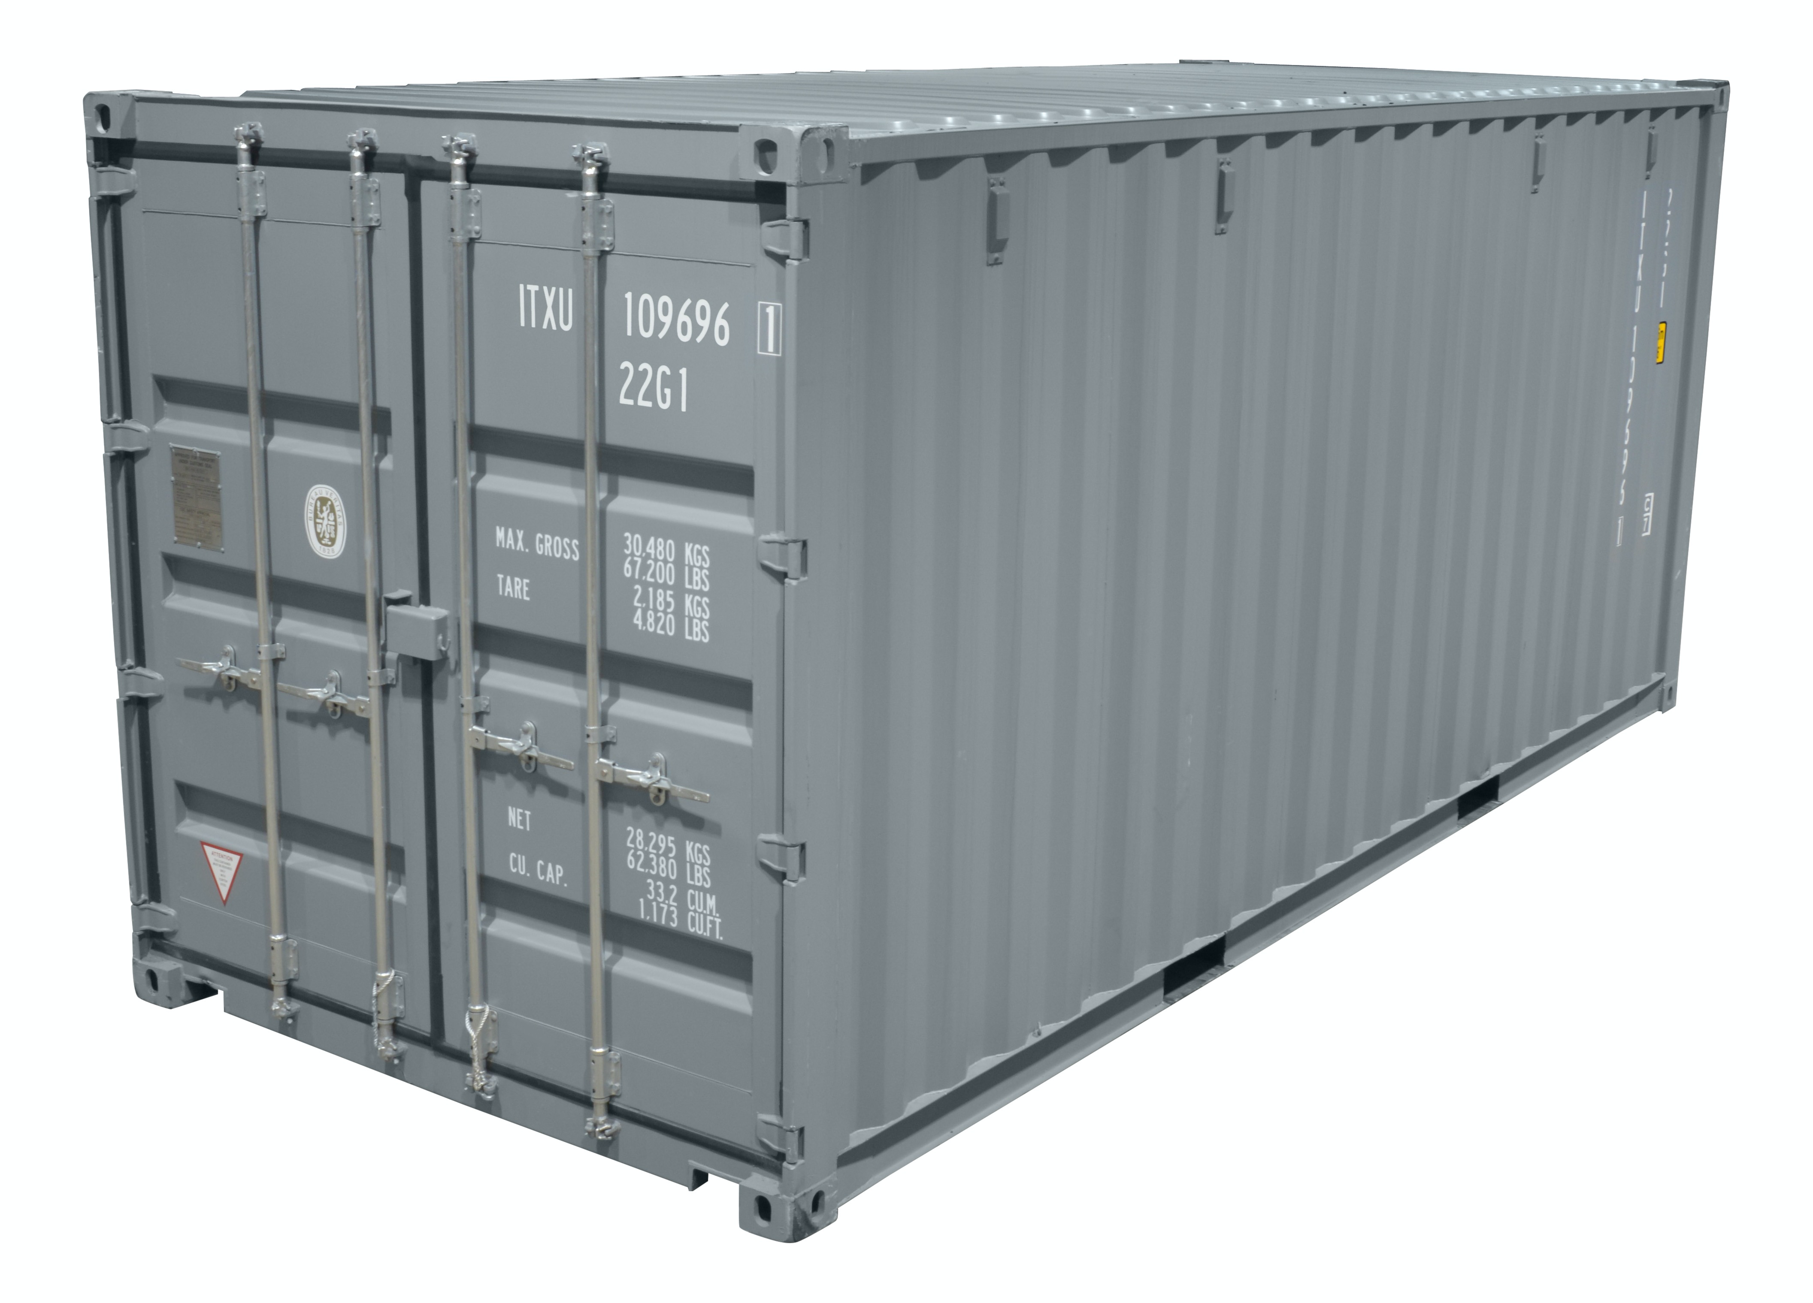
Inversion of control container
Class A
IB ib ??
ib.foo()
Wprowadzając interface rozdzielamy zależność
Loosly coupled
Obie klasy zależą od interfejsu
- Żadna klasa nie zależy od drugiej
IoC container
interface IB
foo ()
Class B : IB
foo ()
Register <IB, B>

Slide 17
Dependency injection
Class A
public A(IB ib) or [Inject] IB ib
ib.foo()
Inject instance = Dependency Injection
Wprowadzając interface rozdzielamy zależność
Loosly coupled
Obie klasy zależą od interfejsu
- Żadna klasa nie zależy od drugiej
IoC container
interface IB
foo ()
Class B : IB
foo ()
Register <IB, B>

Slide 18
Dependency injection
Class A
public A(IB ib) or [Inject] IB ib
ib.foo()
Inject instance = Dependency Injection
Wprowadzając interface rozdzielamy zależność
Loosly coupled
Obie klasy zależą od interfejsu
- Żadna klasa nie zależy od drugiej
IoC container
Transient
Scoped
Singleton
interface IB
foo ()
Class B : IB
foo ()
Register <IB, B>

Slide 19
Startup class
ConfigureServices
Dependency Injection configuration
services.AddTransient()
services.AddScoped()
services.AddSingleton()
Adding predefined services
services.AddMvc()
services.AddAuthentication()
Configure
Defining middleware pipeline
app.UseRouting()
app.UseMvc()
app.UseEndpoints()

Slide 20
Application settings
appsettings.json
Appsettings.{Environment}.json
Secret Manager
Environment Variables
Command Line Arguments

Slide 21
Configuration
Host.CreateDefaultBuilder()
IConfiguration
appsettings.json
appsettings.Development.json
appsettings.Production.json
User secrets
Environment variables
Command line arguments

Slide 22
Logging
ILogger, ILogger<T>
_logger.LogInformation()
_logger.LogDebug()
_logger.LogError()
Console logger
Debug logger

Slide 23
Routing
Mapping URLs to code
Conventions and attribute based
Works for any server type
app.UseRouting()
app.UseEndpoints(...)

Slide 24
Static files
wwwroot folder
app.UseStaticFiles()
app.UseDirectoryBrowser()
app.UseDefaultFiles()
app.UseFileServer()

Slide 25
MVC

Slide 26

MVC
Model View Controller

Slide 27
Controllers
Inherit Controller class (or not)
Have action methods
Endpoints with URLs
Triggered with HTTP verbs
GET, POST, PUT, DELETE…
Can have input parameters
processed with model binding
Can return
views or
raw data using content negotiation

Slide 28
Models & View Models
Models
Domain data
Can be loaded from DB
Can have validation
View Models
Or input models, or display models, or DTOs…
Subset of data designed according to the view needs
Subset of data that user will send in request (input model)
Input models should have validation

Slide 29
Razor
.cshtml files
Syntax for embedding server-side code into web pages
Razor markup + C# + HTML

Slide 30
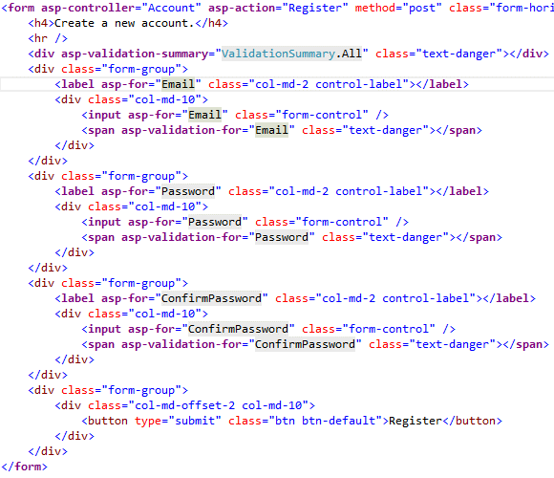
Tag Helpers
Enable server-side code to participate in creating and rendering of HTML elements
<label asp-for=“Product.Name”></label>
<label for=“Product_Name”></label>
Nicer syntax comparing to HTML helpers

Slide 31
Web Components
Doesn’t use model binding
Can have parameters and business logic
Has a C# class and a view
For reusable parts of the view:
Login panel
Shopping cart
Tag cloud
Dynamic menus
…
<wc:my-component parameter1=“value1”> </wc:my-component>

Slide 32
Web API

Slide 33
Similar to MVC
Same controllers
Same models
Similar View Models
No Views - raw data returned

Slide 34
Controllers
Inherit ControllerBase class
[ApiController] attribute
Have action methods
Endpoints with URLs
Triggered with HTTP verbs
GET, POST, PUT, DELETE…
Can have input parameters
processed with model binding
Can return
views or
raw data using content negotiation

Slide 35
Models & View Models
Models
Domain data
Can be loaded from DB
Can have validation
View Models
Or input models, or display models, or DTOs…
Subset of data designed according to the view needs
Subset of data that user will send in request (input model)
Input models should have validation
Notes:
Modele prawdopowobnie beda outsourced do innych projektow

Slide 36
Conventions
[ApiController] attribute
ActionResult<T>
API convention classes
API analyzers
Swagger / Open API specification

Slide 37
Clients
SPA clients (Aurelia, Angular, React, Vue…)
Mobile clients (Android, iOS…)
.NET Clients
HttpClient
HttpClientFactory
Swagger code generation
Notes:
Why it’s a good idea to use HttpClientFactory: https://docs.microsoft.com/en-us/dotnet/standard/microservices-architecture/implement-resilient-applications/use-httpclientfactory-to-implement-resilient-http-requests
NSwag: https://github.com/RicoSuter/Nswag

Slide 38
Data access & auth

Slide 39
Entity Framework Core
ORM - Object-Relational Mapper
Mapping models to db
LINQ for queries (or raw SQL)
Multiple databases supported
SQL Server, SQLite, InMemory
CosmosDB
PostgreSQL, MySQL, Maria
Oracle
…
DB versioning and migrations for code first or SSDT
Notes:
dbpack

Slide 40
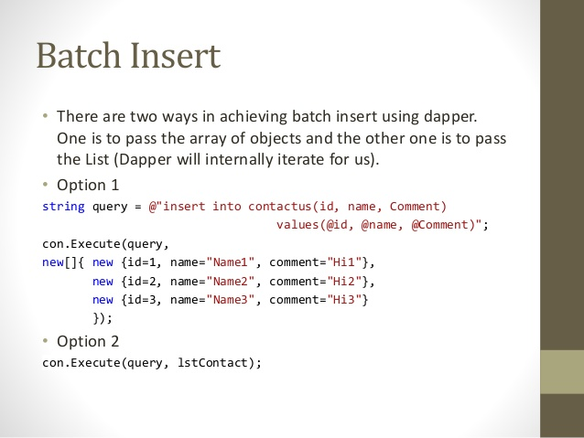
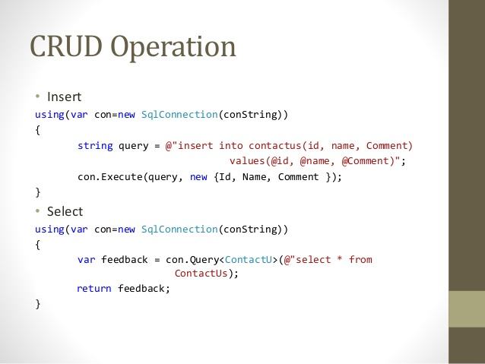
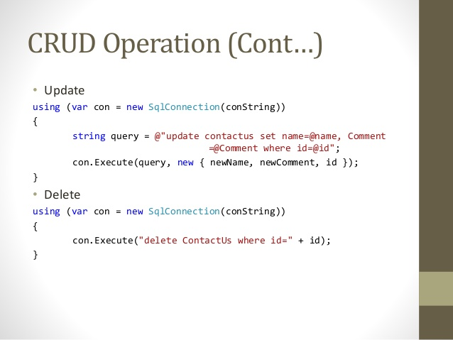
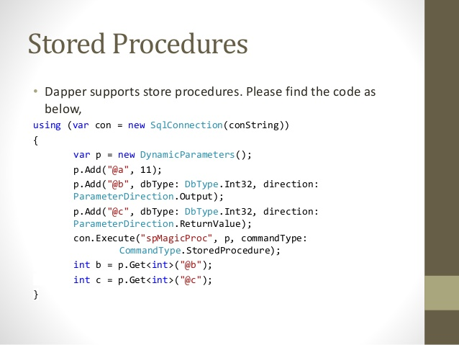
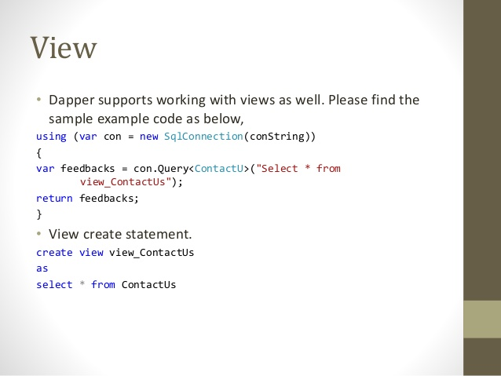
Dapper
Dapper.NET is an Open-Source, Micro ORM developed by the developers of Stack Overflow
Ultra fast – performance is a key feature
Pure SQL
Maps query result to list of POCOs or dynamics
Support for Stored Procedures views and transactions
Single file with less then 700 lines of code (including comments)
Queries caching
https://github.com/StackExchange/Dapper

Slide 41
Authentication & Authorization
Authentication middleware
Authorization middleware
[Authorize] filters
OAuth 2.0 & OpenID Connect

Slide 42
ASP.NET Core Identity
Local authentication
username and password
OpenID authentication
Google, Microsoft, Twitter, Facebook…
Federated authentication
Active Directory, Azure AD, Windows authentication…
Full solution
Views and logic for user registration and authentication
Scaffolding

Slide 43
Identity Server
Advanced scenarios
OAuth 2.0 and OpenID Connect server

Slide 44
Thanks! Questions?

